Slide 1
Coherency Sensitive Hashing
Simon Korman and Shai Avidan
Tel-Aviv University
Notes:
The topic of the talk is Coherency Sensitive Hashing
This is a joint work with Shai Avidan from the Tel-Aviv University

Slide 2
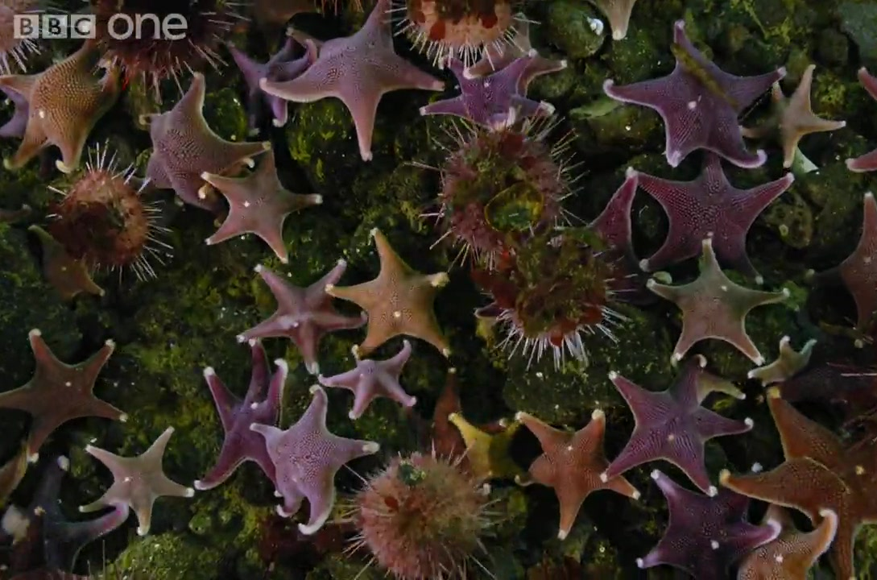
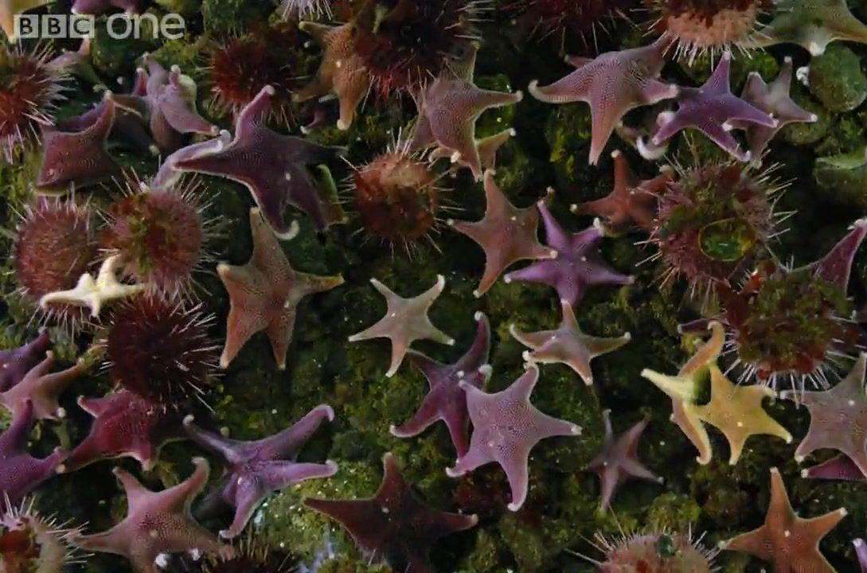
Nearest Neighbor Fields (NNF)
For each patch – find nearest patch in other image
Dense : Number of patches ≈ image size
Exact NN is infeasible
Error is mean(patch-distances)
A
B
NNF
Notes:
The problem we tackle is that of finding a Nearest Neighbor Field between a pair of related images.
That is, for each patch of an image ‘A’, one needs to find the most similar patch in an image ‘B’.
This is a dense type of problem, where we consider sliding window kind of patches in both images.
For this reason, exact Nearest Neighbor calculation is very difficult so people settle for approximations.
The way we evaluate the accuracy of the mapping is by taking the average distance between matching patches.
--------------------------------------------------------------
Computing Approximate Nearest Neighbor Fields
(ANNF) is an important building block in many computer
vision and graphics applications such as texture synthesis
[10], image editing [18] and image denoising [7]
This is a challenging task because the number of patches in an image
is in the millions and one needs to ﬁnd Approximate Nearest
Neighbors (ANN) for each patch in real or near real time.

Slide 3
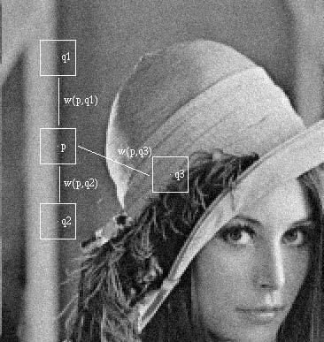
Why NNF?
Non-Local Means denoising
Non Local Means. Baudes, Coll, Morel. CVPR 2005
Notes:
What do we need this kind of NN Field for?
One good example is in the Non-Local-Means denoising algorithm.
In this algorithm, each pixel is replaced by an average of all other pixels in the image, where the weight in the averaging is taken according to the distance between the containing patches.
For computational reasons, one could only use a small neighborhood around each pixel. However, if we had an NNf between the image and itself, we could be able to incorporate in the averaging other patches from across the image.
--------------------------------------------------------------
Computing Approximate Nearest Neighbor Fields
(ANNF) is an important building block in many computer
vision and graphics applications such as texture synthesis
[10], image editing [18] and image denoising [7]
This is a challenging task because the number of patches in an image
is in themillions and one needs to ﬁnd Approximate Nearest
Neighbors (ANN) for each patch in real or near real time.

Slide 4
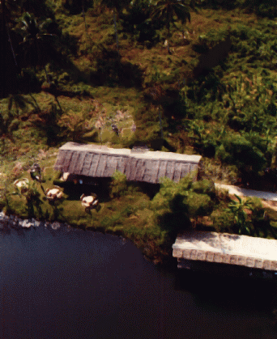
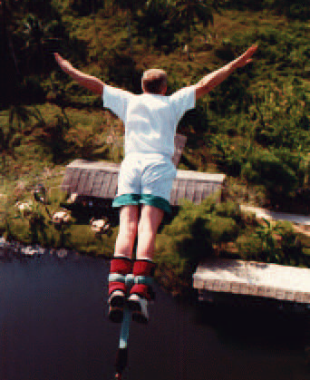
Why NNF?
Image Completion
Object Removal by Examplar Based Inpainting. Criminisi et al’, CVPR 2003
Space-Time Completion. Wexler et al’, CVPR 2004
Notes:
Another example is that of Image Completion.
Some methods for this task are based on iterative computations of NNFs between the masked area and the outer area of the image.
--------------------------------------------------------------
Computing Approximate Nearest Neighbor Fields
(ANNF) is an important building block in many computer
vision and graphics applications such as texture synthesis
[10], image editing [18] and image denoising [7]
This is a challenging task because the number of patches in an image
is in themillions and one needs to ﬁnd Approximate Nearest
Neighbors (ANN) for each patch in real or near real time.

Slide 5
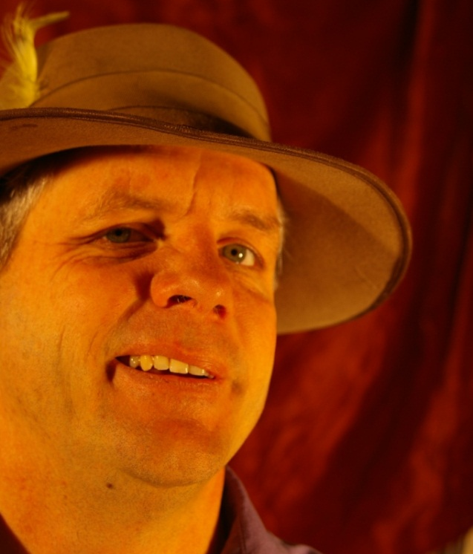
Appearance Space
k-by-k patch = k² dimensional vector
Ordinary Nearest Neighbor search
Two popular methods are:
KD-trees [Arya et al, 1998]
Locality Sensitive Hashing (LSH) [Indyk et al, 1998]
These methods
Can be very accurate
Are relatively slow
Notes:
The traditional way to go with computing NNFs is by searching for the nearest patches in appearance space.
Throwing all the patches into high dimensional space, this becomes an ordinary Nearest Neighbor Search.
The common indexing techniques for this are KD-Trees and Locality Sensitive Hashing.
The nice thing about them is that they can be as accurate as needed, but this comes at a high cost in runtime.
------------------------------------------------------------------------------
In the past, it was customary to compute ANNF with
traditional approximate nearest neighbor tools such as Lo-
cality Sensitive Hashing (LSH) [13] or KD-trees [1, 16].
These tools perform well in terms of accuracy but are not as
fast as one would hope. Recently, a novel method, termed
PatchMatch [4], proved to outperform those methods by up
to two orders of magnitude, making applications that rely
on ANNF run at interactive rate

Slide 6
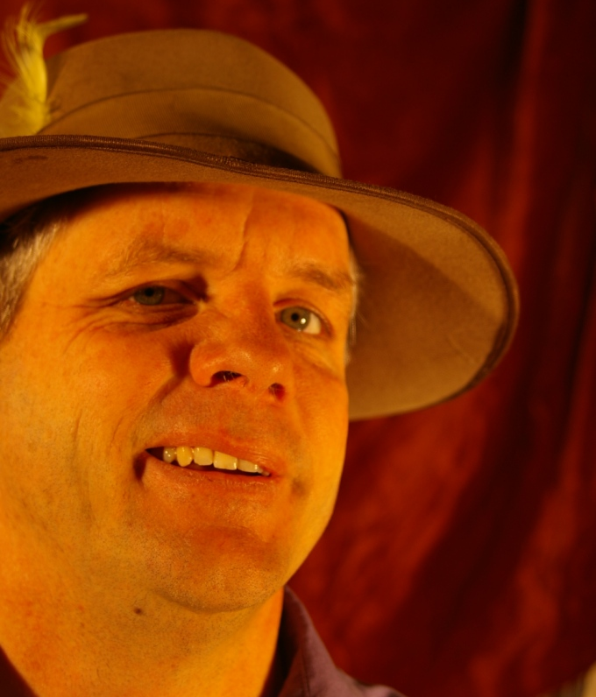
Image Space
Based on coherency
Notes:
Another way to go is to search in Image Space.
If we are given the green pair of matching patches and look at the neighboring blue patch – the corresponding blue patch is likely to give a good match as well.
These are highly overlapping patches in natural images which are generally quite smooth.
This is coherency.
--------------------------------------------------------------------------
In the past, it was customary to compute ANNF with
traditional approximate nearest neighbor tools such as Lo-
cality Sensitive Hashing (LSH) [13] or KD-trees [1, 16].
These tools perform well in terms of accuracy but are not as
fast as one would hope. Recently, a novel method, termed
PatchMatch [4], proved to outperform those methods by up
to two orders of magnitude, making applications that rely
on ANNF run at interactive rate

Slide 7
Image Space - the PatchMatch algorithm [Barnes et al, SIGRAPH 2009]
Each iteration, for each pixel:
Compare two kinds of candidates (patches):
1. Randomly located patches (with probability that drops exponentially with distance from current match)
current match
candidates

Slide 8
Image Space - the PatchMatch algorithm [Barnes et al, SIGRAPH 2009]
Each iteration, for each pixel:
Compare two kinds of candidates (patches):
2. Propagated neighbor’s matches
left neighbor
current match of left neighbor
candidate

Slide 9
Image Space - the PatchMatch algorithm [Barnes et al, SIGRAPH 2009]
Each iteration, for each pixel:
Compare two kinds of candidates (patches):
2. Propagated neighbor’s matches
top neighbor
current match of top neighbor
left neighbor
current match of left neighbor
candidates

Slide 10
Image Space - the PatchMatch algorithm [Barnes et al, SIGRAPH 2009]
An iterative randomized algorithm
Simple and fast (runtime is in the seconds)
Based on local propagation and mostly-local search
Heavily relies on the fact that images are generally coherent
Notes:
Recently, a novel method, termed
PatchMatch [4], proved to outperform those methods by up
to two orders of magnitude, making applications that rely
on ANNF run at interactive rate. The key to this speedup
is that PatchMatch relies on the fact that images are generally
coherent. That is, if we find a pair of similar patches,
in two images, then their neighbors in the image plane are
also likely to be similar. PatchMatch uses a random search
to seed the patch matches and iterates for a small number
of times to propagate good matches

Slide 11
Coherency Sensitive Hashing (CSH)
Combine image space and appearance space
Find good matches
Propagate them across patches that either:
Are neighbors (image space)
Share hash values (appearance space)
Notes:
Coherency Sensitive Hashing (CSH) comes to combine search in both appearance and image space.
We use an LSH based index which enables us to find good matches and then propagate these matches across other patches that are either neighbors (this is image space) or that share common hash values (this is appearance space)
Coherency Sensitive Hashing (CSH) replaces the ran-
dom search step of PatchMatch with a hashing scheme, sim-
ilar to the one used in LSH. As a result, the process of seed-
ing good matches is much more targeted and information
is propagated much more efﬁciently. Speciﬁcally, informa-
tion is propagated to nearby patches in the image plane, as is
done in PatchMatch, and to similar patches that were hashed
to the same value. In other words, we propagate information
to patches that are close in the image plane or are similar in
appearance. The end result is that our algorithm runs faster
and gives more accurate results, in terms of RMS of the re-
trieved patches, compared to PatchMatch. This increased
speed and accuracy comes at a modest increase in memory
footprint since we need to store the hashing tables

Slide 12
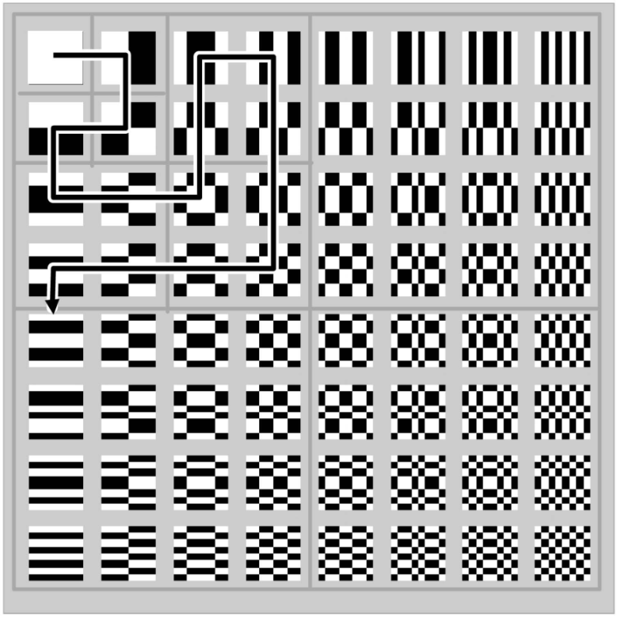
CSH - The LSH Framework
Project each point v on a random segmented line
Hash function (code)
Bin number
Walsh Hadamard (WH) Basis
LSH table
3
4
5
6
7
8
4
5
6
7
8
9
6
7
8
9
10
11
Datar, Immorlica, Indyk, Mirrokni, 2004
The Gray-Code Filter Kernels, Hel-Or, Hel-Or, PAMI 2007
Notes:
Coherency Sensitive Hashing (or CSH), starts from the LSH framework.
Here, looking at high dimensional points in space, each point v is projected onto a random line.
The projection is described by the following formula. ‘a’ is the random line, ‘r’ is the width of the bins that the line is divided into and ‘b’ is a random shift of the bins along the line. Each point v is assigned the number of the bin that it is projected into.
This process is repeated, projecting the point on several random lines and the final code ‘g’ is the concatenation of the bin numbers that a point is assigned under each projection. Once we have these codes, each point can be hashed into a hash table and it can be shown that close points in space will be hashed together with high probability.
In our case, these points are the image’s patches and the main modification we make is in replacing the random lines ‘a_i’ by the leading vectors of the 2-dimensional Walsh-Hadamard basis. These projections can be computed rapidly at only 2 operations per pixel and produce a very effective dimension reduction of the space of patches.
The notion of locality sensitive hashing (LSH) was ﬁrst
introduced by Indyk and Motwani [13]. Given a set of
points in a metric space, LSH function families have the
property that points that are close to each other have a
higher probability of colliding (under random members of
the family) compared to points that are far apart. The ﬁrst
usage of LSH for nearest neighbor search in high dimen-
sions worked in high dimensional binary Hamming space
[11]. Our algorithm will follow the general lines of an LSH-
based approximate nearest neighbor search scheme later
proposed by Datar et al. [8]. In the rest of this section
we outline their algorithm.
At the base of the algorithm is a family H of LSH func-
tions and the ANN search algorithm consists of two stages:
indexing and search (query). In the indexing stage, prim-
itive hash functions from H are used to create an index
in which similar points map into the same hash bins with
high probability. M such primitive hash functions are con-
catenated to create a code which ampliﬁes the gap between
the collision probability of far away points and the colli-
sion probability of nearby points. Such a code creates a
single hash table, by evaluating it on all data-set points. In
the search stage, a query point is hashed into a table bin,
from which the nearest of residing data-set points is cho-
sen. In order to decrease the probability of falling into an
empty bin (with no data-set points), multiple (L) random
codes are used to create L hash tables, which are searched
sequentially at search stage. Datar et al.[8] show that the
above scheme results in signiﬁcantly improved efﬁciency
compared to previous methods in the case of L2 distances,
which are the ones of interest in our case.

Slide 13
CSH indexing
Hash all patches of both images (with hash function g)
Hash Table
Image ‘A’
Image ‘B’
 |  |  |  |  | p
g
g
Notes:
In CSH indexing we map all patches of both images into a hash table, using such a function ‘g’.
-----------------------------------------------------------------------
In the past, it was customary to compute ANNF with
traditional approximate nearest neighbor tools such as Lo-
cality Sensitive Hashing (LSH) [13] or KD-trees [1, 16].
These tools perform well in terms of accuracy but are not as
fast as one would hope. Recently, a novel method, termed
PatchMatch [4], proved to outperform those methods by up
to two orders of magnitude, making applications that rely
on ANNF run at interactive rate

Slide 14
CSH indexing
Hash all patches of both images (with hash function g)
Keep k (=2) representatives of each image in each entry
Hash Table
Image ‘A’
k
k
Image ‘B’
 |  |  |  |  | p
g
g⁻¹
g⁻¹
g
Notes:
From now on I will only draw the top-left pixel of each patch and we will keep ‘k’ representative patches from each image in each entry of the hash-table.
------------------------------------------------------------------------------------
In the past, it was customary to compute ANNF with
traditional approximate nearest neighbor tools such as Lo-
cality Sensitive Hashing (LSH) [13] or KD-trees [1, 16].
These tools perform well in terms of accuracy but are not as
fast as one would hope. Recently, a novel method, termed
PatchMatch [4], proved to outperform those methods by up
to two orders of magnitude, making applications that rely
on ANNF run at interactive rate

Slide 15
CSH indexing - candidates
Candidates = potential matching patches
Image ‘A’
Image ‘B’
Notes:
The idea in CSH indexing is to create, for each patch of image ‘A’ a rich set of candidate patches in image ‘B’, from which we will later select the best match.
--------------------------------------------------------------------------
In the past, it was customary to compute ANNF with
traditional approximate nearest neighbor tools such as Lo-
cality Sensitive Hashing (LSH) [13] or KD-trees [1, 16].
These tools perform well in terms of accuracy but are not as
fast as one would hope. Recently, a novel method, termed
PatchMatch [4], proved to outperform those methods by up
to two orders of magnitude, making applications that rely
on ANNF run at interactive rate

Slide 16
CSH indexing – candidate types
Type I (appearance only) = Standard LSH
Image ‘A’
Image ‘B’
Notes:
We generate 3 different types of such candidates.
The generation of the first type is based on appearance only and it is exactly the set of candidates that standard LSH would have used.
Starting from a patch in image ‘A’. We hash it into the table and the candidates will be those in image ‘B’ with the same code.
----------------------------------------------------------------------
In the past, it was customary to compute ANNF with
traditional approximate nearest neighbor tools such as Lo-
cality Sensitive Hashing (LSH) [13] or KD-trees [1, 16].
These tools perform well in terms of accuracy but are not as
fast as one would hope. Recently, a novel method, termed
PatchMatch [4], proved to outperform those methods by up
to two orders of magnitude, making applications that rely
on ANNF run at interactive rate

Slide 17
CSH indexing – candidate types
Type II (appearance and coherence)
Image ‘A’
Image ‘B’
PM candidate
Notes:
The second type candidates are based on appearance and coherence.
Starting from the left neighbor of the patch, we can use its current match to produce a candidate patch.
This is exactly the candidate that PM uses in its propagation stage.
We go one step further, using appearance and take other patches in ‘B’ that share the same hash code.
-----------------------------------------------------------------------
In the past, it was customary to compute ANNF with
traditional approximate nearest neighbor tools such as Lo-
cality Sensitive Hashing (LSH) [13] or KD-trees [1, 16].
These tools perform well in terms of accuracy but are not as
fast as one would hope. Recently, a novel method, termed
PatchMatch [4], proved to outperform those methods by up
to two orders of magnitude, making applications that rely
on ANNF run at interactive rate

Slide 18
CSH indexing – candidate types
Type III (appearance only)
Image ‘A’
Image ‘B’
Notes:
And - the third type. Taking patches in image ‘A’ and using their current matches as new candidates.
-----------------------------------------------------------------------
In the past, it was customary to compute ANNF with
traditional approximate nearest neighbor tools such as Lo-
cality Sensitive Hashing (LSH) [13] or KD-trees [1, 16].
These tools perform well in terms of accuracy but are not as
fast as one would hope. Recently, a novel method, termed
PatchMatch [4], proved to outperform those methods by up
to two orders of magnitude, making applications that rely
on ANNF run at interactive rate

Slide 19
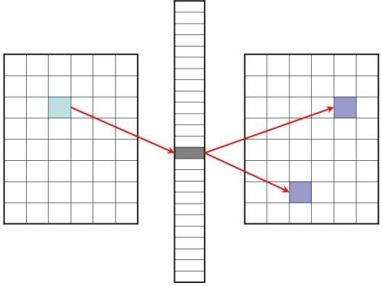
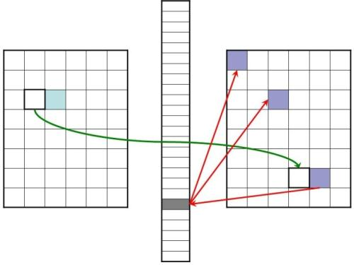
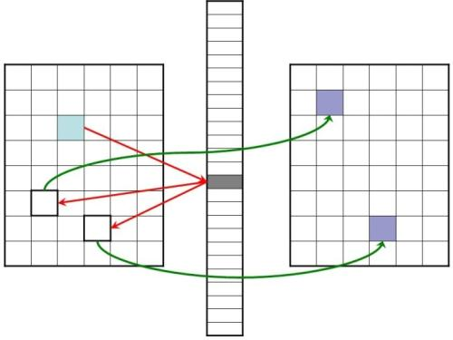
CSH indexing – candidate types
Type 1
Type 2
 | Type 1 | Type 2 | Type 3
Uses appearance | ✓ | ✓ | ✓
Uses coherence |  | ✓
# candidates | 2 | 4 - 6 | 2
Estimated contribution | 20% | 50% | 30%
Type 3
(LSH)
(> PM)
Notes:
Summarizing the different candidate types we generate.
At the last row of the table is the estimated contribution of each candidate type, which we checked empirically. If we look at the final mapping that is produced, the distribution of the matchings of each of the types is 20, 30 and 50 percent for types 1, 2 and 3. This is interesting, taking into account that type 1 is exactly LSH and type 2 is a superset of the patches that PM uses in its propagation stage.
-----------------------------------------------------------------------
In the past, it was customary to compute ANNF with
traditional approximate nearest neighbor tools such as Lo-
cality Sensitive Hashing (LSH) [13] or KD-trees [1, 16].
These tools perform well in terms of accuracy but are not as
fast as one would hope. Recently, a novel method, termed
PatchMatch [4], proved to outperform those methods by up
to two orders of magnitude, making applications that rely
on ANNF run at interactive rate

Slide 20
CSH Algorithm – recap
Preprocessing:
Project A’s and B’s patches on WH vectors
Iterate (typically 1-3 times):
Hash patches into a table
For each patch in A
Create candidate patches in B
Pick the best one
* further details in the paper
A
B
Notes:
Let’s now look at the outline of the algorithm.
We start with a preprocessing stage, projecting all patches on the WH vectors.
Then we iterate the following:
First hash the patches into the table
Then, for each patch in ‘A’, create the candidate patches in ‘B’ and pick the best
-----------------------------------------------------------------------
In the past, it was customary to compute ANNF with
traditional approximate nearest neighbor tools such as Lo-
cality Sensitive Hashing (LSH) [13] or KD-trees [1, 16].
These tools perform well in terms of accuracy but are not as
fast as one would hope. Recently, a novel method, termed
PatchMatch [4], proved to outperform those methods by up
to two orders of magnitude, making applications that rely
on ANNF run at interactive rate

Slide 21
CSH Algorithm – recap
Preprocessing:
Project A’s and B’s patches on WH vectors
Iterate (typically 1-3 times):
Hash patches into a table
For each patch in A
Create candidate patches in B
Pick the best one
* further details in the paper
A
B
Notes:
Let’s now look at the outline of the algorithm.
We start with a preprocessing stage, projecting all patches on the WH vectors.
Then we iterate the following:
First hash the patches into the table
Then, for each patch in ‘A’, create the candidate patches in ‘B’ and pick the best
-----------------------------------------------------------------------
In the past, it was customary to compute ANNF with
traditional approximate nearest neighbor tools such as Lo-
cality Sensitive Hashing (LSH) [13] or KD-trees [1, 16].
These tools perform well in terms of accuracy but are not as
fast as one would hope. Recently, a novel method, termed
PatchMatch [4], proved to outperform those methods by up
to two orders of magnitude, making applications that rely
on ANNF run at interactive rate

Slide 22
CSH Algorithm – Hashing
5
6
1
4
2
3
3
1
2
4
Notes:
Let’s now look at the outline of the algorithm.
We start with a preprocessing stage, projecting all patches on the WH vectors.
Then we iterate the following:
First hash the patches into the table
Then, for each patch in ‘A’, create the candidate patches in ‘B’ and pick the best
-----------------------------------------------------------------------
In the past, it was customary to compute ANNF with
traditional approximate nearest neighbor tools such as Lo-
cality Sensitive Hashing (LSH) [13] or KD-trees [1, 16].
These tools perform well in terms of accuracy but are not as
fast as one would hope. Recently, a novel method, termed
PatchMatch [4], proved to outperform those methods by up
to two orders of magnitude, making applications that rely
on ANNF run at interactive rate

Slide 23
CSH Algorithm – Hashing
The reasoning being:
number of bins - relative to the dispersion of points along the projection line
Less bins the higher the kernel frequency
Less bins for color channels compared to Y
spacing of bins – attempting to capture a constant number of points in each bin
Use fixed percentiles
over the distribution
Notes:
Let’s now look at the outline of the algorithm.
We start with a preprocessing stage, projecting all patches on the WH vectors.
Then we iterate the following:
First hash the patches into the table
Then, for each patch in ‘A’, create the candidate patches in ‘B’ and pick the best
-----------------------------------------------------------------------
In the past, it was customary to compute ANNF with
traditional approximate nearest neighbor tools such as Lo-
cality Sensitive Hashing (LSH) [13] or KD-trees [1, 16].
These tools perform well in terms of accuracy but are not as
fast as one would hope. Recently, a novel method, termed
PatchMatch [4], proved to outperform those methods by up
to two orders of magnitude, making applications that rely
on ANNF run at interactive rate

Slide 24
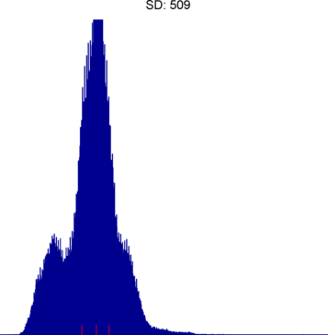
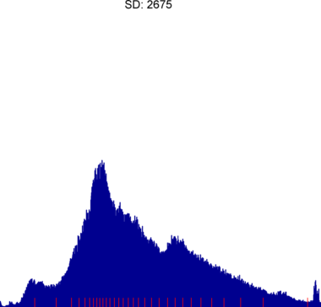
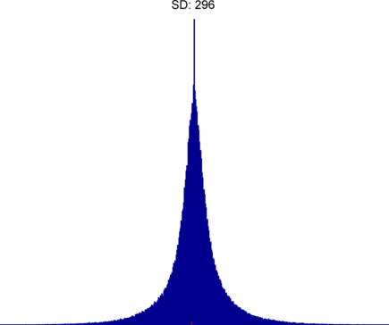
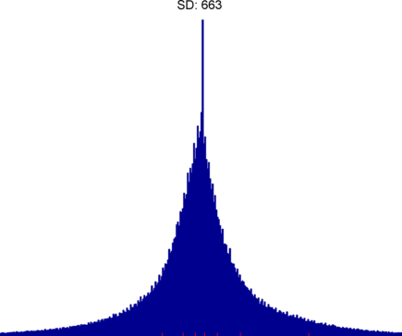
CSH Algorithm – Hashing
kernel (DC)
Y channel
– 32 bins
kernel (DC)
Cb channel
– 4 bins
kernel
Y channel
- 8 bins
kernel
Y channel
- 2 bins
Notes:
Let’s now look at the outline of the algorithm.
We start with a preprocessing stage, projecting all patches on the WH vectors.
Then we iterate the following:
First hash the patches into the table
Then, for each patch in ‘A’, create the candidate patches in ‘B’ and pick the best
-----------------------------------------------------------------------
In the past, it was customary to compute ANNF with
traditional approximate nearest neighbor tools such as Lo-
cality Sensitive Hashing (LSH) [13] or KD-trees [1, 16].
These tools perform well in terms of accuracy but are not as
fast as one would hope. Recently, a novel method, termed
PatchMatch [4], proved to outperform those methods by up
to two orders of magnitude, making applications that rely
on ANNF run at interactive rate

Slide 25
CSH Algorithm – recap
Preprocessing:
Project A’s and B’s patches on WH vectors
Iterate (typically 1-3 times):
Hash patches into a table
For each patch in A
Create candidate patches in B
Pick the best one
* further details in the paper
A
B
Notes:
Let’s now look at the outline of the algorithm.
We start with a preprocessing stage, projecting all patches on the WH vectors.
Then we iterate the following:
First hash the patches into the table
Then, for each patch in ‘A’, create the candidate patches in ‘B’ and pick the best
-----------------------------------------------------------------------
In the past, it was customary to compute ANNF with
traditional approximate nearest neighbor tools such as Lo-
cality Sensitive Hashing (LSH) [13] or KD-trees [1, 16].
These tools perform well in terms of accuracy but are not as
fast as one would hope. Recently, a novel method, termed
PatchMatch [4], proved to outperform those methods by up
to two orders of magnitude, making applications that rely
on ANNF run at interactive rate

Slide 26
CSH Algorithm – comparing candidates
Notes:
Let’s now look at the outline of the algorithm.
We start with a preprocessing stage, projecting all patches on the WH vectors.
Then we iterate the following:
First hash the patches into the table
Then, for each patch in ‘A’, create the candidate patches in ‘B’ and pick the best
-----------------------------------------------------------------------
In the past, it was customary to compute ANNF with
traditional approximate nearest neighbor tools such as Lo-
cality Sensitive Hashing (LSH) [13] or KD-trees [1, 16].
These tools perform well in terms of accuracy but are not as
fast as one would hope. Recently, a novel method, termed
PatchMatch [4], proved to outperform those methods by up
to two orders of magnitude, making applications that rely
on ANNF run at interactive rate

Slide 27
Experiments - setup
Vid-Pairs data-set
133 related pairs of ~2 MP images
Up to 30 frames apart in the video
Include both camera and object motion
A
B
Notes:
Most our experiments are on a new data-set we created.
It includes 133 pairs of images taken from hi-definition movie trailers. These are quite challenging image pairs, since they typically include both camera and object motion. The data-set is available on-line.
-----------------------------------------------------------------------
In the past, it was customary to compute ANNF with
traditional approximate nearest neighbor tools such as Lo-
cality Sensitive Hashing (LSH) [13] or KD-trees [1, 16].
These tools perform well in terms of accuracy but are not as
fast as one would hope. Recently, a novel method, termed
PatchMatch [4], proved to outperform those methods by up
to two orders of magnitude, making applications that rely
on ANNF run at interactive rate

Slide 28
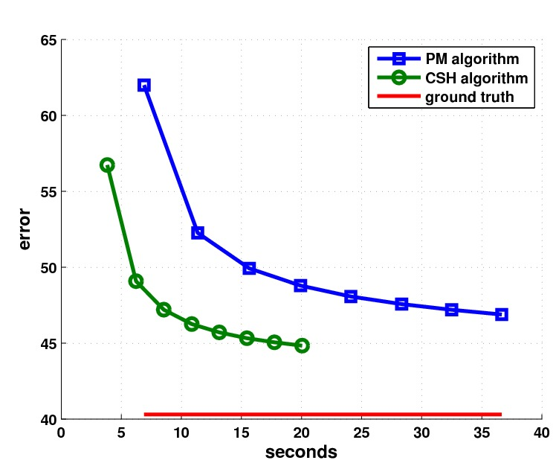
Experiments - accuracy/efficiency
Notes:
Here, we compare CSH in the green to PatchMatch in blue.
We ran both algorithms over the complete data set, measuring the errors at each of the first 8 iterations.
Horizontal axis is the runtime, while the vertical axis is the error, which is the average L2 distance between matching patches.
We can see that CSH reaches lower error rates and converges much faster.
We also computed the ground truth exact nearest neighbor matches (this took half a day for a pair of images). These are in red.
The differences in error rates compared to the ground truth are quite dramatic.
----------------------------------------------------------------------

Slide 29
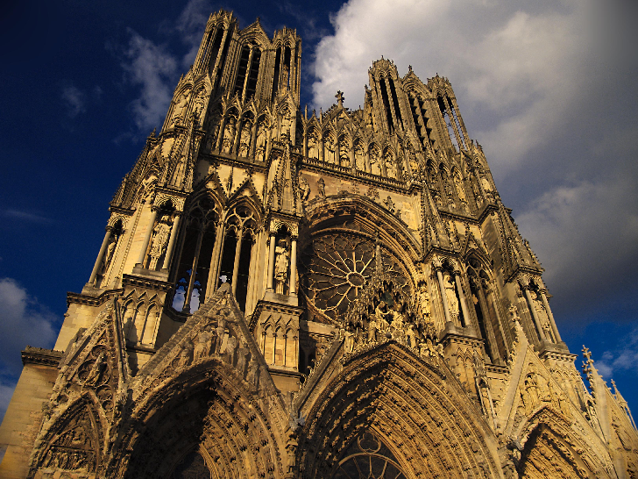
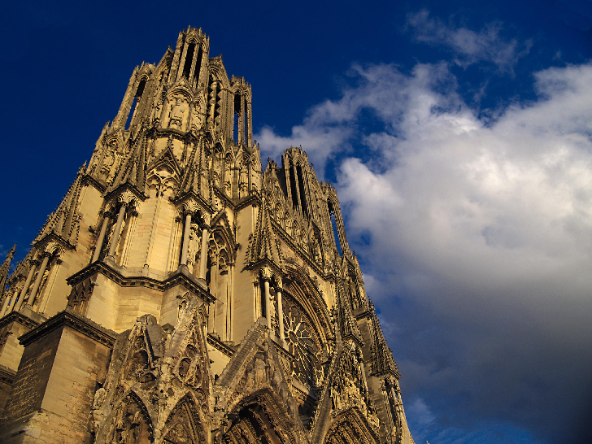
Experiments – Image Reconstruction
Reconstruct image A, given: B and A->B
Each pixel is an avg. of corresponding pixels through the mapping
Main ingredient in many patch based algorithms (retargetting, inpainting, denoising, super-resolution, etc.)
Image ‘A’
Image ‘B’
?
PM
NNF
CSH
GT
Notes:
Another experiment we ran is what we call ‘image reconstruction’.
Given a pair of images, we compute the NNF between them and then, try to reconstruct image ‘A’, given only image ‘B’ and the NN mapping.
The reconstruction was done by taking each pixel to be the simple average of all pixels it is mapped to by its containing patches.
This kind of reconstruction is a basic building block many patch based algorithms.
The advantage of having the original image in the experiment is that you can compare it to the reconstructed image, both visually and quantitatively.
-------------------------------------------------------------
In the past, it was customary to compute ANNF with
traditional approximate nearest neighbor tools such as Lo-
cality Sensitive Hashing (LSH) [13] or KD-trees [1, 16].
These tools perform well in terms of accuracy but are not as
fast as one would hope. Recently, a novel method, termed
PatchMatch [4], proved to outperform those methods by up
to two orders of magnitude, making applications that rely
on ANNF run at interactive rate

Slide 30
Experiments – Image Reconstruction
Notes:
So here is the reconstruction using the ground truth mapping.

Slide 31
Experiments – Image Reconstruction
Notes:
In the past, it was customary to compute ANNF with
traditional approximate nearest neighbor tools such as Lo-
cality Sensitive Hashing (LSH) [13] or KD-trees [1, 16].
These tools perform well in terms of accuracy but are not as
fast as one would hope. Recently, a novel method, termed
PatchMatch [4], proved to outperform those methods by up
to two orders of magnitude, making applications that rely
on ANNF run at interactive rate

Slide 32
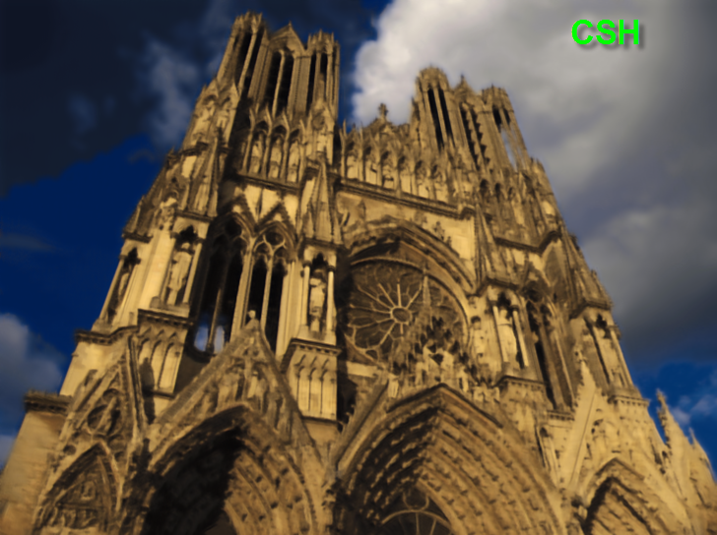
Experiments – Image Reconstruction
Notes:
In the past, it was customary to compute ANNF with
traditional approximate nearest neighbor tools such as Lo-
cality Sensitive Hashing (LSH) [13] or KD-trees [1, 16].
These tools perform well in terms of accuracy but are not as
fast as one would hope. Recently, a novel method, termed
PatchMatch [4], proved to outperform those methods by up
to two orders of magnitude, making applications that rely
on ANNF run at interactive rate

Slide 33
Experiments – Image Reconstruction
Notes:
We can see that the CSH reconstruction, compared to that of PatchMatch is much sharper and has less color and other artifacts.

Slide 34
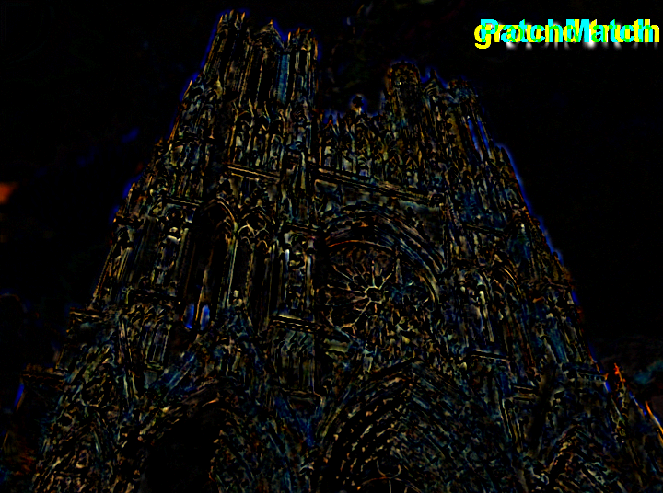
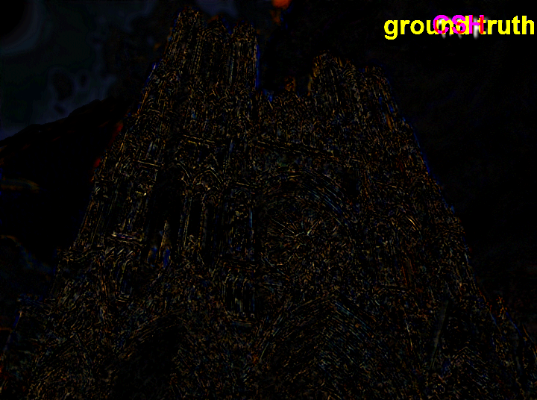
Experiments – Image Reconstruction
PM vs. GT
CSH vs. GT
 | PatchMatch | CSH | Ground Truth
Reconstruction RMSE (avg. on 133 pairs) | 7.62 | 6.29 | 5.81
Notes:
Here, we can see the reconstruction differences between PM and GT versus the difference between CSH and the GT.
You can notice the greater differences on the PM side, especially in the areas with edges.
We measured the average errors on the complete data-set and found that the CSH reconstruction are between those of the GT and those of PM, but actually closer to the ground truth errors.

Slide 35
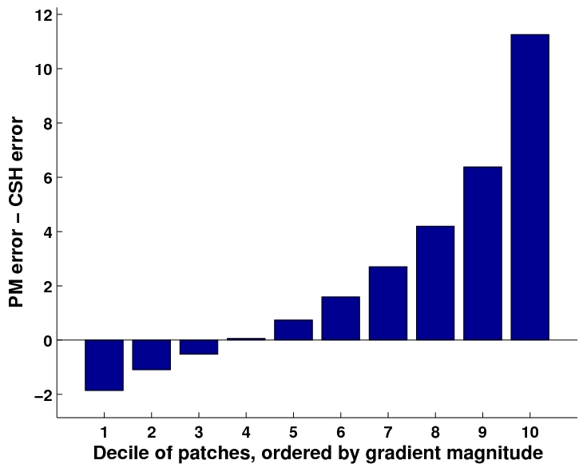
Dependence on patch energy
Notes:
One reason for the visual differences in reconstruction is in the following.
If we take a look at the patches of image ‘A’ and sort them according to an increasing order their spatial energy, measured by the average gradient magnitude.
For instance, the yellow patch of the sky will be in the lowest 10 percent, while the green patch will be in the highest.
If we look at the difference between PM and CSH reconstruction errors, we can clearly see that the higher the patch energy is, the better our reconstruction is.
Actually, PM does slightly better in the flat, homogeneous areas, but doing well in the textured areas is of a greater visual importance for the reconstruction.

Slide 36
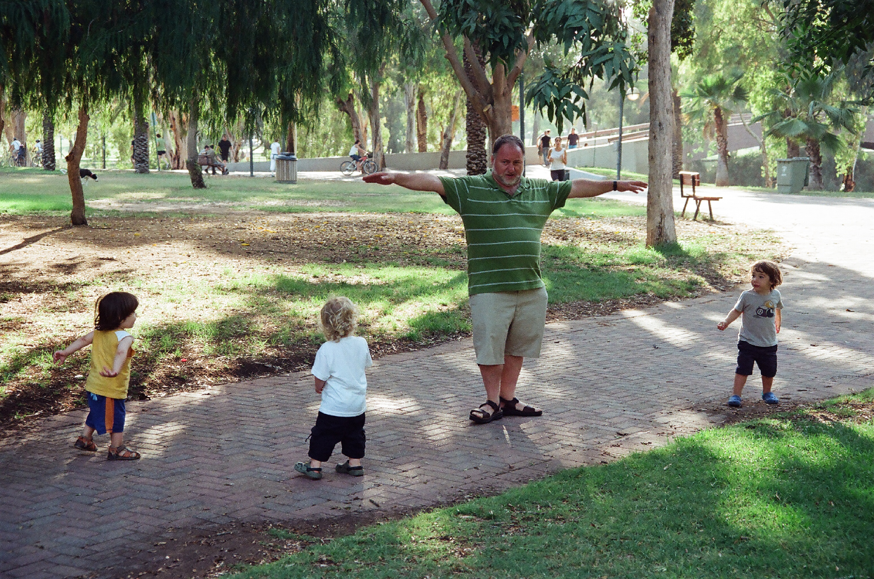
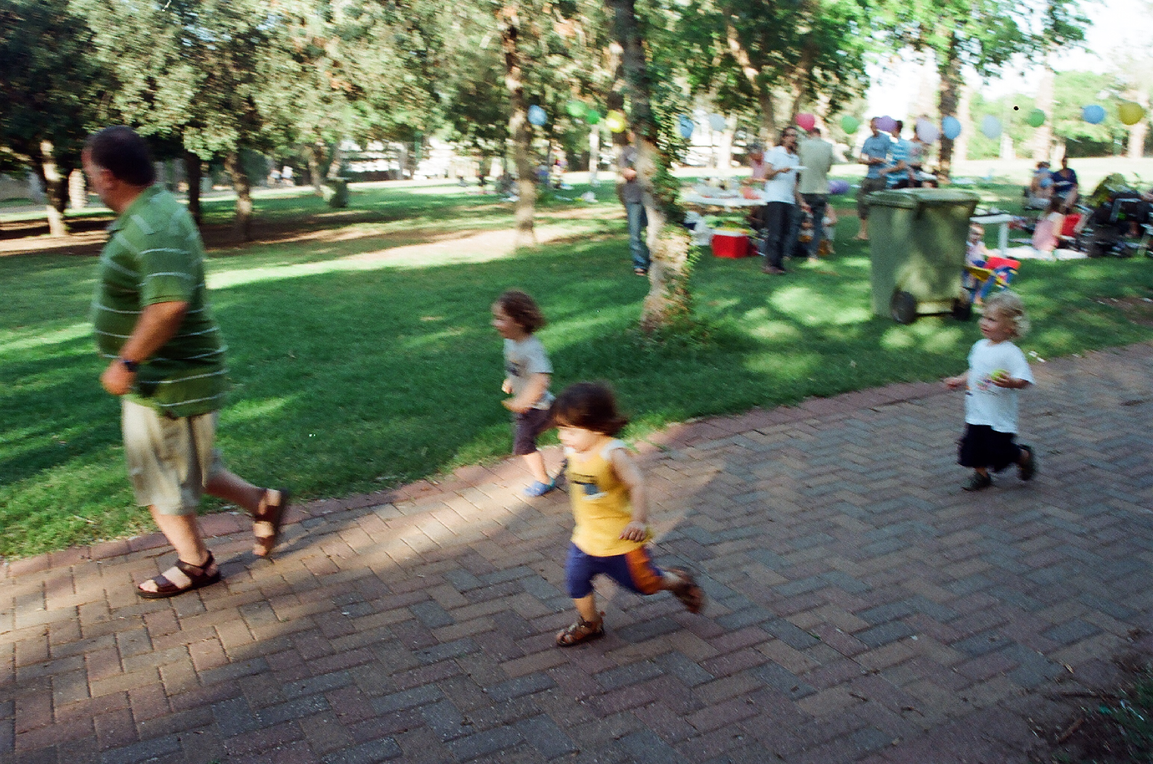
Experiments – Image Reconstruction
Image ‘A’
Image ‘B’
?
NNF
Notes:
Another example of reconstruction.

Slide 37
Experiments – Image Reconstruction
Reconstruct image A,
given only image B and an NNF mapping A->B
Notes:
In the past, it was customary to compute ANNF with
traditional approximate nearest neighbor tools such as Lo-
cality Sensitive Hashing (LSH) [13] or KD-trees [1, 16].
These tools perform well in terms of accuracy but are not as
fast as one would hope. Recently, a novel method, termed
PatchMatch [4], proved to outperform those methods by up
to two orders of magnitude, making applications that rely
on ANNF run at interactive rate

Slide 38
Experiments – Image Reconstruction
Reconstruct image A,
given only image B and an NNF mapping A->B
Notes:
In the past, it was customary to compute ANNF with
traditional approximate nearest neighbor tools such as Lo-
cality Sensitive Hashing (LSH) [13] or KD-trees [1, 16].
These tools perform well in terms of accuracy but are not as
fast as one would hope. Recently, a novel method, termed
PatchMatch [4], proved to outperform those methods by up
to two orders of magnitude, making applications that rely
on ANNF run at interactive rate

Slide 39
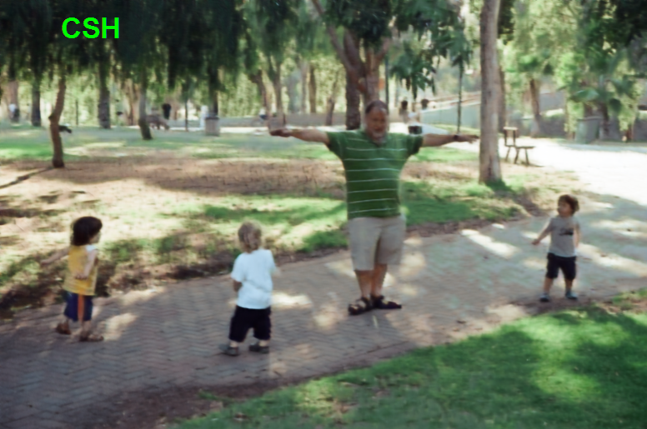
Experiments – Image Reconstruction
Reconstruct image A,
given only image B and an NNF mapping A->B
Notes:
In the past, it was customary to compute ANNF with
traditional approximate nearest neighbor tools such as Lo-
cality Sensitive Hashing (LSH) [13] or KD-trees [1, 16].
These tools perform well in terms of accuracy but are not as
fast as one would hope. Recently, a novel method, termed
PatchMatch [4], proved to outperform those methods by up
to two orders of magnitude, making applications that rely
on ANNF run at interactive rate

Slide 40
Experiments – Image Reconstruction
Reconstruct image A,
given only image B and an NNF mapping A->B
Notes:
In the past, it was customary to compute ANNF with
traditional approximate nearest neighbor tools such as Lo-
cality Sensitive Hashing (LSH) [13] or KD-trees [1, 16].
These tools perform well in terms of accuracy but are not as
fast as one would hope. Recently, a novel method, termed
PatchMatch [4], proved to outperform those methods by up
to two orders of magnitude, making applications that rely
on ANNF run at interactive rate

Slide 41
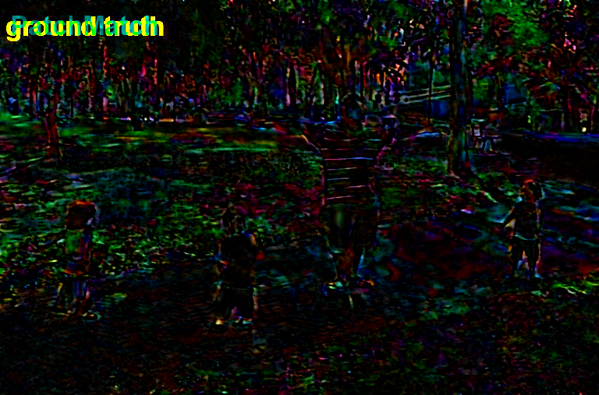
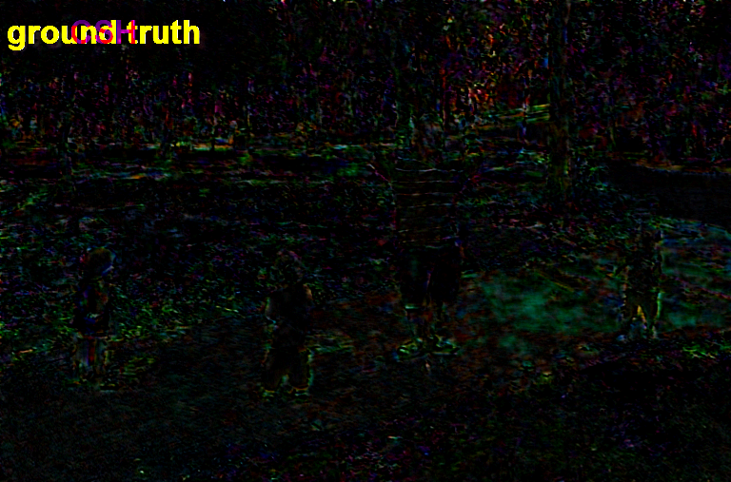
Experiments – Image Reconstruction
PM vs. GT
CSH vs. GT
Notes:
In the past, it was customary to compute ANNF with
traditional approximate nearest neighbor tools such as Lo-
cality Sensitive Hashing (LSH) [13] or KD-trees [1, 16].
These tools perform well in terms of accuracy but are not as
fast as one would hope. Recently, a novel method, termed
PatchMatch [4], proved to outperform those methods by up
to two orders of magnitude, making applications that rely
on ANNF run at interactive rate

Slide 42
Experiments – Mapping Incoherency
CSH
PM
Notes:
Another reason we discovered for our superior reconstruction capabilities is in what we call the ‘mapping incoherency’.
If we compare the PM versus CSH produced mappings by looking at a single pixel in image ‘A’ – here, the gray pixel. Since the PM search is only in image space, what typically happens is that the patches containing the pixels typically map coherently to the other image. However, the containing patches in the case of CSH are mapped much more incoherently. In any reconstruction framework, such a gray pixel will be an average of the pixels it is mapped to and this will turn out to be much more effective the larger the incoherency is. The extreme case we se here is that you might be averaging on a single value.

Slide 43
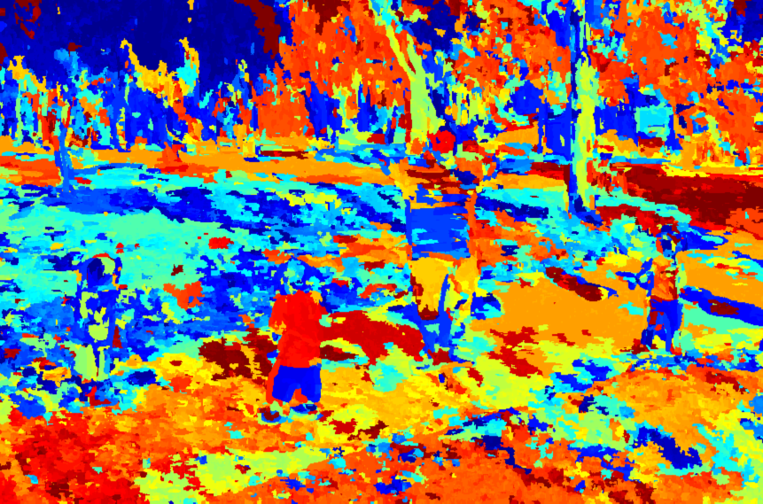
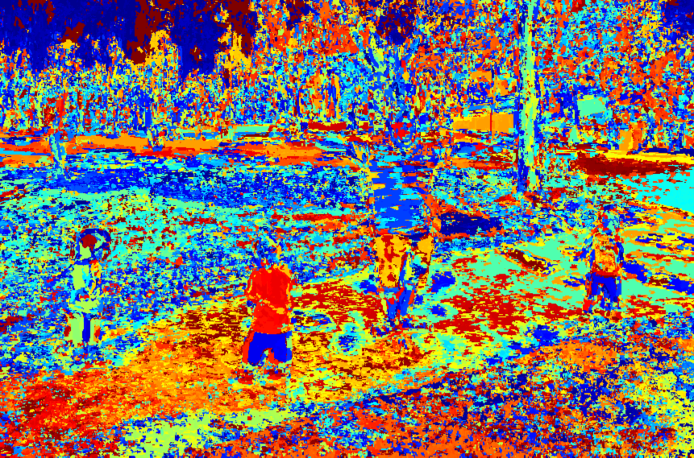
Experiments – Mapping (In)coherency
Image ‘A’
Image ‘B’
CSH
PM
‘x’-coordinate of PM mapping
‘x’-coordinate of CSH mapping
Notes:
We’re going to see here how much more incoherent the CSH mapping is, in comparison to that of PM.
So, if we
We can see that the mapping is very peicewise smooth, where large continguos areas move coherently to a limited area of the target image.
Unlike that, if we look at the CSH mapping, we can see that because it incorporates appearance in its search, its mapping is far less limited than the PM one and this is a reason for its better quality.

Slide 44
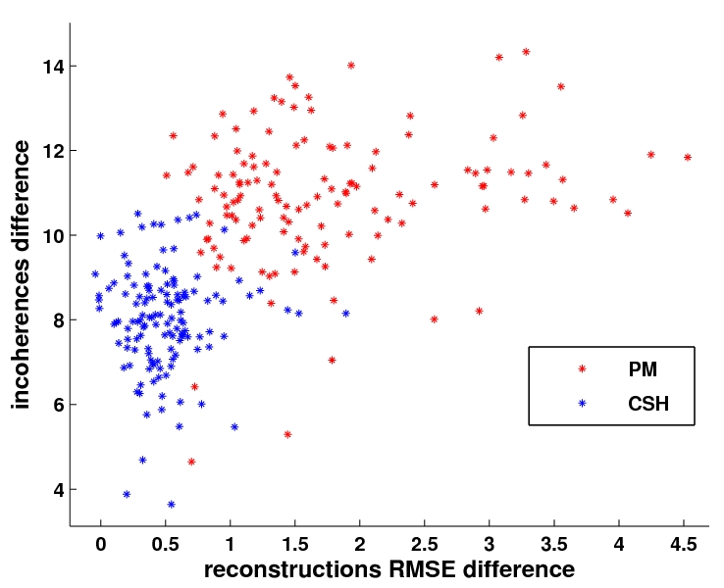
Reconstruction-Error vs. Incoherency
Good
(exact NN)
bad

Slide 45
Summary - CSH
A new algorithm for NNF
combines appearance space and image space
accuracy speed
other pleasing properties
Reconstruction, Incoherency, Texture
Limitations
Small data (images, patches)
Closely related image pairs
Additional memory for hash tables
Currently doesn’t support scale, rotation, illumination
Notes:
In the past, it was customary to compute ANNF with
traditional approximate nearest neighbor tools such as Lo-
cality Sensitive Hashing (LSH) [13] or KD-trees [1, 16].
These tools perform well in terms of accuracy but are not as
fast as one would hope. Recently, a novel method, termed
PatchMatch [4], proved to outperform those methods by up
to two orders of magnitude, making applications that rely
on ANNF run at interactive rate

Slide 46
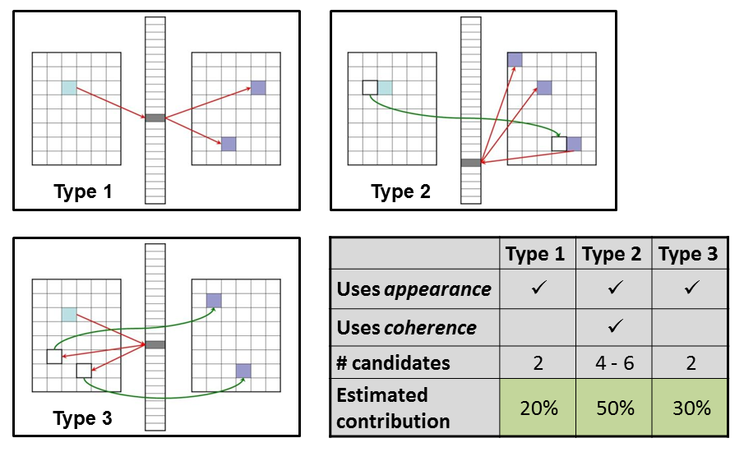
THANK YOU!
source code, data-set, more info, available at:
http://www.eng.tau.ac.il/~simonk/CSH
Notes:
In the past, it was customary to compute ANNF with
traditional approximate nearest neighbor tools such as Lo-
cality Sensitive Hashing (LSH) [13] or KD-trees [1, 16].
These tools perform well in terms of accuracy but are not as
fast as one would hope. Recently, a novel method, termed
PatchMatch [4], proved to outperform those methods by up
to two orders of magnitude, making applications that rely
on ANNF run at interactive rate

